Slide 1

ML Summary and Next Steps in Illustrations Data X: A Course on Data, Signals, and Systems
Data ^{X}
About Me:
Ikhlaq Sidhu Chief Scientist & Founding Director, Sutardja Center for Entrepreneurship & Technology IEOR Emerging Area Professor Award, UC Berkeley

Slide 2
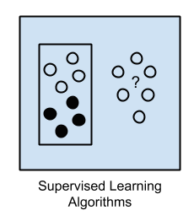
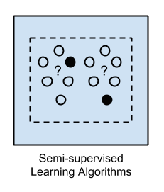
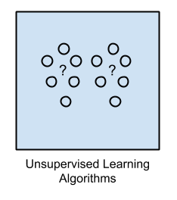
Overview

Slide 3
Overview
#Setting up for Supervised learning
# First clean: use mapping + buckets
# X = matrix of data – e.g 1000 rows
# Y = In sample responses
# Typically we want to split in to training data and test data
X_train = X[0:500]
Y_train = Y[0:500]
X_test = X[501:1000]
Y_test = Y[501:1000]

Slide 4
Linear Regression Illustration
#Setting Linear Regression in sklearn
from sklearn import linear_model
model= linear_model.LinearRegression()
model.fit(X_train, Y_train)
Y_pred_train = model.predict(X_train)
Y_pred_test = model.predict(X_test)
# Compare Y_pred_test with Y_test for error.
Illustration Source:

Slide 5
Logistic Regression Illustration
Illustration Source:

Slide 6
Logistic Regression Illustration
from sklearn.linear_model import LogisticRegression
# Logistic Regression
logreg = LogisticRegression()
logreg.fit(X_train, Y_train)
Y_pred = logreg.predict(X_test)
# Error
acc_log = round(logreg.score(X_train, Y_train) * 100, 2)
acc_log
# or compare Y_pred with Y_test
Illustration Source:

Slide 7
Support Vector Machine (SVM) Illustration
Illustration Source:

Slide 8
Support Vector Machine (SVM) Illustration
from sklearn.svm import SVC, LinearSVC
svc = SVC()
svc.fit(X_train, Y_train)
Y_pred = svc.predict(X_test)
# Error
acc_svc = round(svc.score(X_train, Y_train) * 100, 2)
acc_svc
# or compare Y_pred with Y_test
Illustration Source:

Slide 9
Support Vector Machine (SVM) Illustration
from sklearn.svm import SVC, LinearSVC
# Linear SVC
linear_svc = LinearSVC()
linear_svc.fit(X_train, Y_train)
Y_pred = linear_svc.predict(X_test)
# Error:
acc_linear_svc = round(linear_svc.score(X_train, Y_train) * 100, 2)acc_linear_svc
# or compare Y_pred with Y_test
Illustration Source:

Slide 10
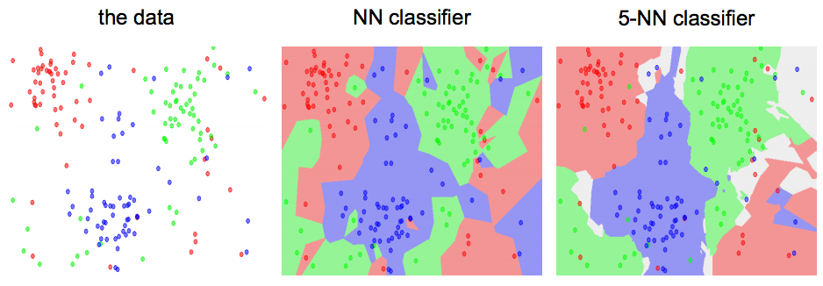
KNN / K Means Illustration
KNN Method: Find the k nearest images and have them vote on the label (i.e. take the mode)
Illustration Source:

Slide 11
K Means / KNN Illustration
from sklearn.neighbors import KNeighborsClassifier
knn = KNeighborsClassifier(n_neighbors = 3)
knn.fit(X_train, Y_train)
Y_pred = knn.predict(X_test)
acc_knn = round(knn.score(X_train, Y_train) * 100, 2)
acc_knn
# or compare Y_pred with Y_test
KNN Method: Find the k nearest images and have them vote on the label (i.e. take the mode)
Illustration Source:

Slide 12
Our experiment with the Titanic Data Set
 | Model | Score
 | Random Forest | 86.76
 | Decision Tree | 86.76
 | KNN | 84.74
 | Support Vector Machines | 83.84
 | Logistic Regression | 80.36
 | Linear SVC | 79.01
 | Perceptron | 78.00
 | Naive Bayes | 72.28
 | Stochastic Gradient Decent | 72.28
More Accuracy
Generally more training time
More risk of overfitting
Less Accuracy
Generally less computation

Slide 13
Decision Tree Illustration
Illustration Source:

Slide 14
Decision Tree Illustration
from sklearn import tree
decision_tree = DecisionTreeClassifier()
decision_tree.fit(X_train, Y_train)
Y_pred = decision_tree.predict(X_test)
# Error
acc_decision_tree = round(decision_tree.score(X_train, Y_train) * 100, 2)
acc_decision_tree
# or compare Y_pred with Y_test
Illustration Source:

Slide 15
How Are Trees Created?
 | Attributes |  |  |  | Target
 | Hour | Weather | Accident | Stall | Commute
D1 | 8 AM | Sunny | No | No | Long
D2 | 8 AM | Cloudy | No | Yes | Long
D3 | 10 AM | Sunny | No | No | Short
D4 | 9 AM | Rainy | Yes | No | Long
D5 | 9 AM | Sunny | Yes | Yes | Long
D6 | 10 AM | Sunny | No | No | Short
D7 | 10 AM | Cloudy | No | No | Short
D8 | 9 AM | Rainy | No | No | Medium
D9 | 9 AM | Sunny | Yes | No | Long
D10 | 10 AM | Cloudy | Yes | Yes | Long
D11 | 10 AM | Rainy | No | No | Short
D12 | 8 AM | Cloudy | Yes | No | Long
D13 | 9 AM | Sunny | No | No | Medium
Leave At
10 AM
9 AM
8 AM
Stall?
Accident?
Long
No
Yes
No
Yes
Short
Long
Medium
Long
Example from Jeff Story, source Internet

Slide 16
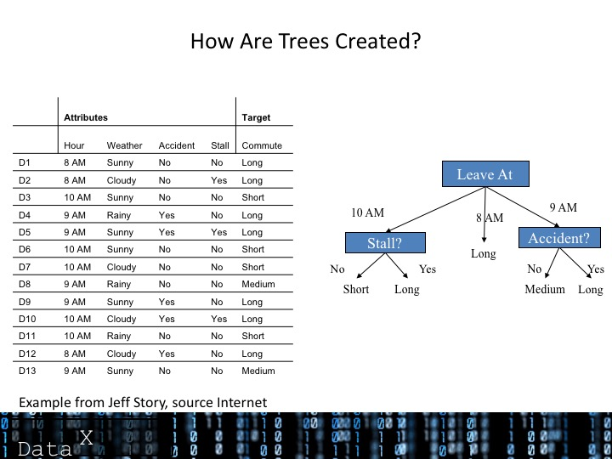
How Are Trees Created?
Prediction can be coded
All features might even be
not be used (Occam’s Razor)
if hour == 8am
commute time = long
else if hour == 9am
if accident == yes
commute time = long
else
commute time = medium
else if hour == 10am
if stall == yes
commute time = long
else
commute time = short
Example from Jeff Story, source Internet

Slide 17
How Are Trees Created?
But how do we choose the order of decisions in the tree?
Most Famous: ID3 Algorithm:
ID3 splits on attributes with the lowest entropy (highest information gained)
Attribute | Expected Entropy | Information Gain
Hour | 0.6511 | 0.768449
Weather | 1.28884 | 0.130719
Accident | 0.92307 | 0.496479
Stall | 1.17071 | 0.248842
Example from Jeff Story, source Internet

Slide 18
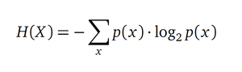
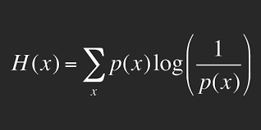
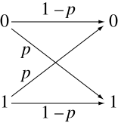
What is Entropy?
A Measure of a distribution P(X)
1 with prob 1
x =
Outcome / Reception
Suppose outcome = 1
0 with prob 0
1 with prob 0.5
x =
Outcome / Reception
Suppose outcome = 1
0 with prob 0.5

Slide 19
What is Entropy?
Source Internet

Slide 20
Source Internet

Slide 22
Golf Example
Start with table of experiences
Distribution: P(golf) = 9 yes, 5 no 14 observations
We calculate entropy of distribution: playing golf
Need to calculate entropy of each next possible decision (Outlook, Temp, Humidity, and Windy)
Information gained is E(Golf) – E(Subset, Golf),
We choose the next branch to be the decision with the highest information gained for the next branch

Slide 23
Golf Example
Top Level Play Golf Distribution
Y
N
9/14
5/14
E(G) = 9/14 log₂ 1/(9/14)
+ 5/14 log₂ 1/(5/14)
= 0.94
Distribution: P(golf) = 9 yes, 5 no 14 observations
We calculate entropy of distribution: playing golf
Need to calculate entropy of each next possible decision (Outlook, Temp, Humidity, and Windy)
Information gained is E(Golf) – E(Subset, Golf),
We choose the next branch to be the decision with the highest information gained for the next branch

Slide 24
Golf Example
Top Level Play Golf Distribution
Next Level: Play Golf with Outlook
Sunny
Overcast
Rainy
Y
N
Y
N
Y
N
Y
N
9/14
5/14
3/5
2/5
4/4
0/4
2/5
3/5
H(G) = 9/14 log₂ 1/(9/14)
+ 5/14 log₂ 1/(5/14)
= 0.94
H(G,OL) =
P(Sunny) H(G,OL) + P(OV)H(G,OV) + P(Rainy) H(G,Rainy)
= 5/14* 0.971+4/14*0 + 5/14*.971 = 0.693
Info Gained = H(G) - H(G,OL) = 0.94 – 0.693 = 0.247
Do the same with Temp (.29), Windy(.048), and Humidity(.152):
Choose next node to be the one with the most info gained

Slide 25
How Are Trees Constructed
Start with table of experiences
Train = construct a tree. Predict means use the tree
But how do we know which branch should go first, second, next?
Example Source Internet:

Slide 26
Trees Can be Extended with Bagging
from sklearn.ensemble import RandomForestClassifier
random_forest = RandomForestClassifier(n_estimators=1000)
random_forest.fit(X_train, Y_train)
Y_pred = random_forest.predict(X_test)
random_forest.score(X_train, Y_train)
# Error
acc_random_forest = round(random_forest.score(X_train, Y_train) * 100, 2)
acc_random_forest
# or compare Y_pred with Y_test
Explain bagging and Random Forrest

Slide 27
Random Forest – A type of bagging/ensemble approach
X1,1 x1,2… C2
..
xN,1, xN,2… C3
S1
Tree
1
X1,1 x1,2… C2
X2,1 x2,2 … C6
..
xN,1, xN,2… C3
During prediction,
We use
voting
from each subtree
S =
X1,1 x1,2… C2
..
X2,1 x2,2 … C6
Tree
M
SM
Features
Outcomes
Make random subsets with replacement
Advantages: One of most accurate
Efficient prediction over large data
Disadvantages: Overfit and Training time

Slide 28
Linear vs Non-Linear Data Fitting

Slide 29
Our experiment with the Titanic Data Set
 | Model | Score
 | Random Forest | 86.76
 | Decision Tree | 86.76
 | KNN | 84.74
 | Support Vector Machines | 83.84
 | Logistic Regression | 80.36
 | Linear SVC | 79.01
 | Perceptron | 78.00
 | Naive Bayes | 72.28
 | Stochastic Gradient Decent | 72.28
More Accuracy
Generally more training time
More risk of overfitting
Less Accuracy
Generally less computation

Slide 30
Boosting as in AdaBoost
Motivation - a procedure that combines the outputs of many “weak” classifiers to produce a powerful “committee”
A machine learning algorithm
Perform supervised learning
Increments improvement of learned function
Forces the weak learner to generate new hypotheses that make less mistakes on “harder” parts.

Slide 31
General Concept of Boosting

Slide 32
Boosting as in AdaBoost

Slide 33
AdaBoost Algorithm

Slide 34
AdaBoost Algorithm

Slide 35
AdaBoost Algorithm

Slide 39
Neural Network Illustration
Illustration Source:

Slide 40
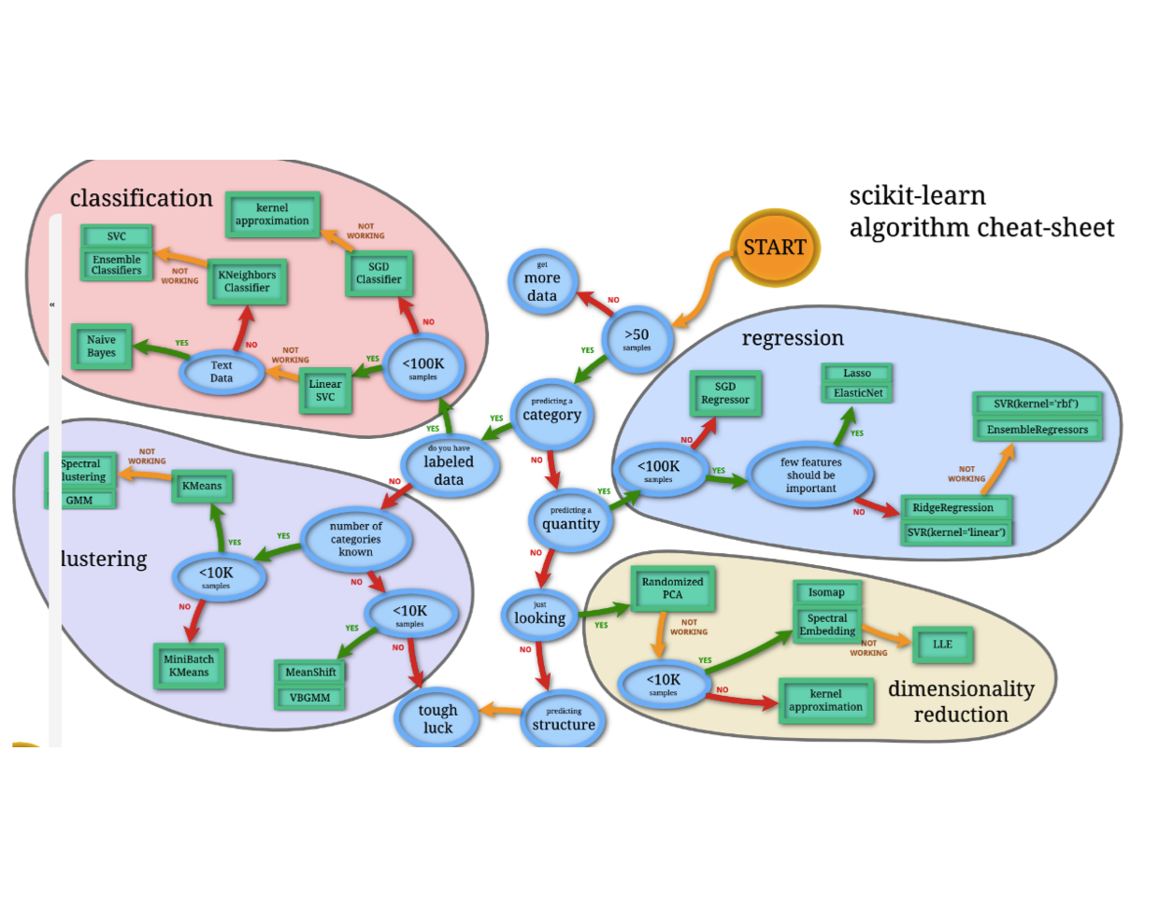
Scikit-Learn Algorithm

Slide 41
Illustration Source:

Slide 42
End of Section

